Slide 1
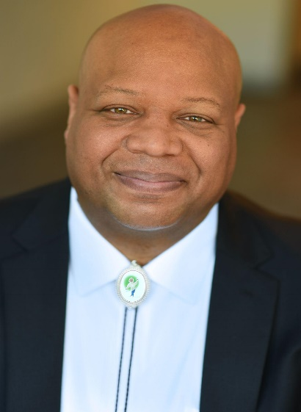
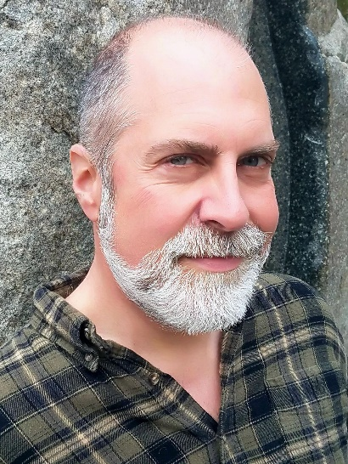
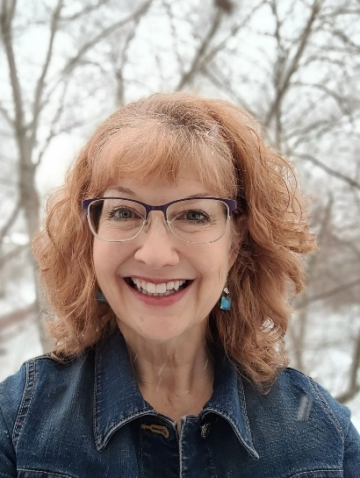
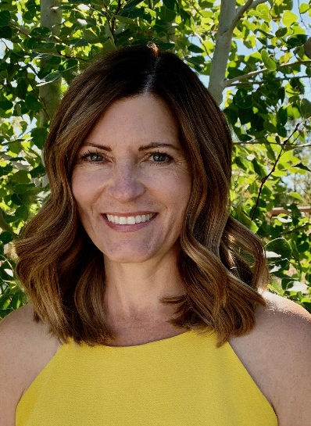
Charles Waters
Matt Forrest
Esenwine
Laura Purdie
Salas
Michelle
Schaub
Poems and Picture Books as Writing Prompts and Conversation Starters

Slide 2
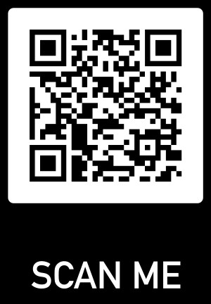
Want to download our slides?

Slide 3




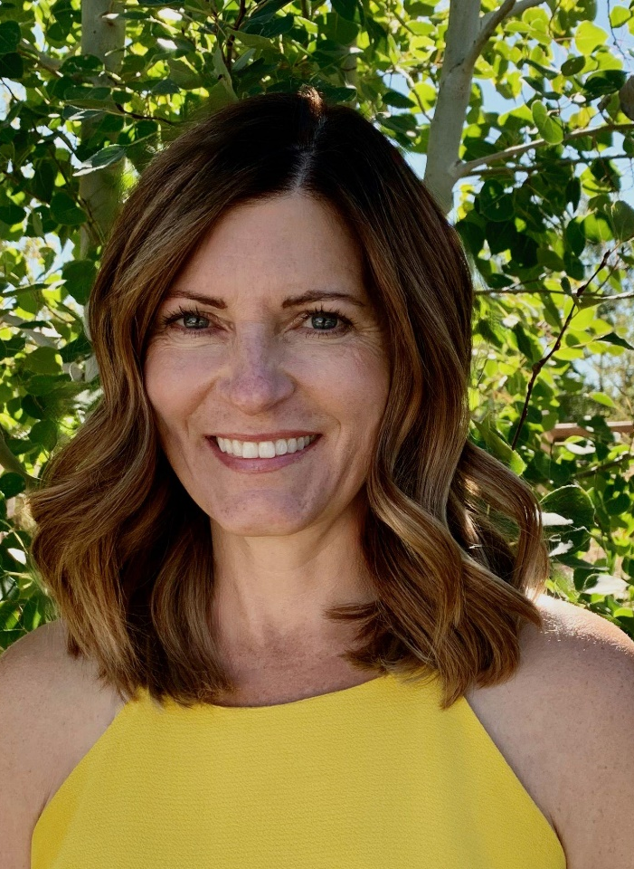


Michelle Schaub
Teacher/Author/Poet
www.MichelleSchaub.com
www.PoetryBoost.com

Slide 4
Goal
To share ways students can compare and contrast events, emotions, and character traits in books and poems to those in their own lives to better understand themselves and the world around them.

Slide 5
Agenda
Each author will provide…
Autobiographical Information
A Peek into Their Books
Example Activities
“Try It” Audience Participation
More Classroom Connections

Slide 6
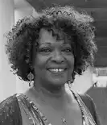
Why Poetry?
“Poetry is language at its most distilled and most powerful.”
-Rita Dove
Concise
Precise
Mirror
Bridge

Slide 7







Charles Waters
Author/Poet/Anthologist
www.charleswaterspoetry.com

Slide 8

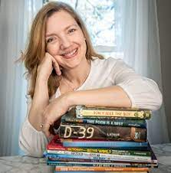
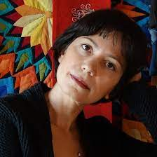
Dictionary For A Better World
Irene Latham Mehrdokht Amini

Slide 9

Dictionary For A Better World Recognition
4 State Lists
Alabama
Alabama Camellia Award
Indiana
Read Aloud Indiana Book Award
2021 AISLE Read Aloud Indiana, Upper Elementary
Pennsylvania
Best of 2020, Grades K-12
Utah
Beehive Award, 2022, Poetry, Grades K-9
Notable Poetry and Verse Novels Selection

Slide 10



Free Teachers Guide and Authors Q & A
Free and Downloadable Teachers Guide and Authors Q & A at:
https://www.charleswaterspoetry.com/books

Slide 11
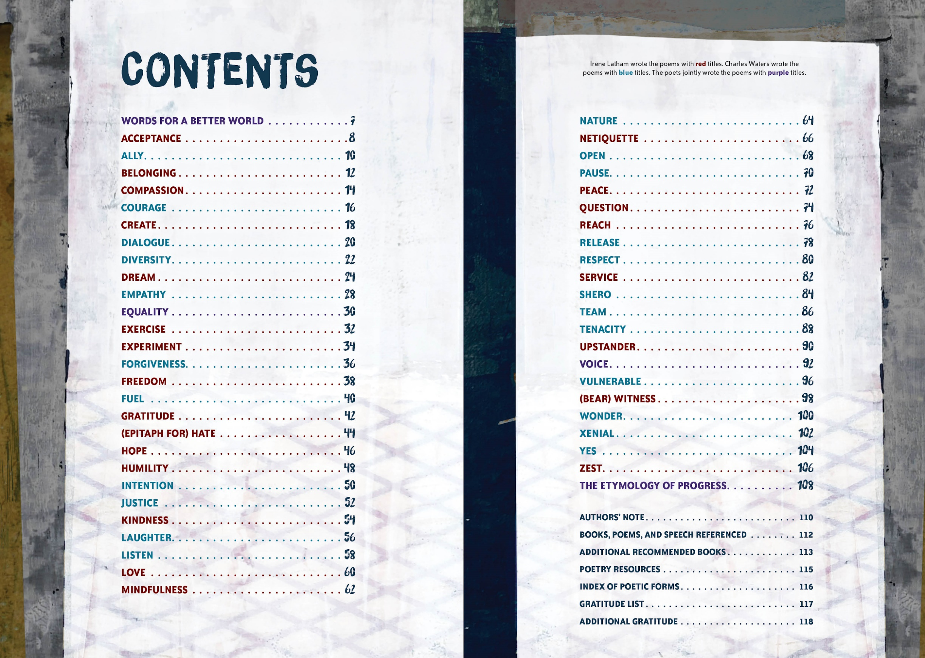

Slide 12
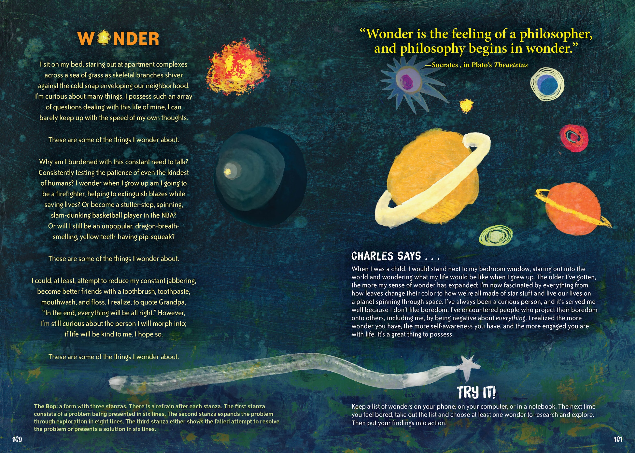

Slide 13
Starters Writer’s Prompt - Create a “Wonder” List
What do you wonder about?
Write down one “Wonder” for each of these things:
Friends. Family. Nature.
*You have one minute to write these down*

Slide 14



Try It! Idea from the book
Keep a list of wonders on your phone, on your computer or in a notebook. The next time you feel bored, take out the list and choose at least one wonder to research and explore. Then put your findings into action.

Slide 15
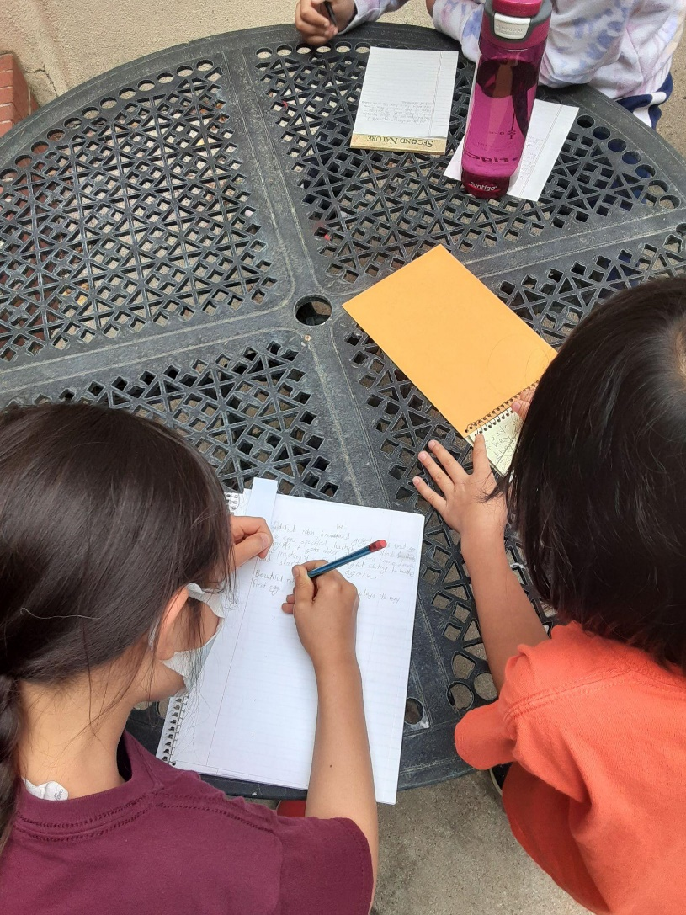
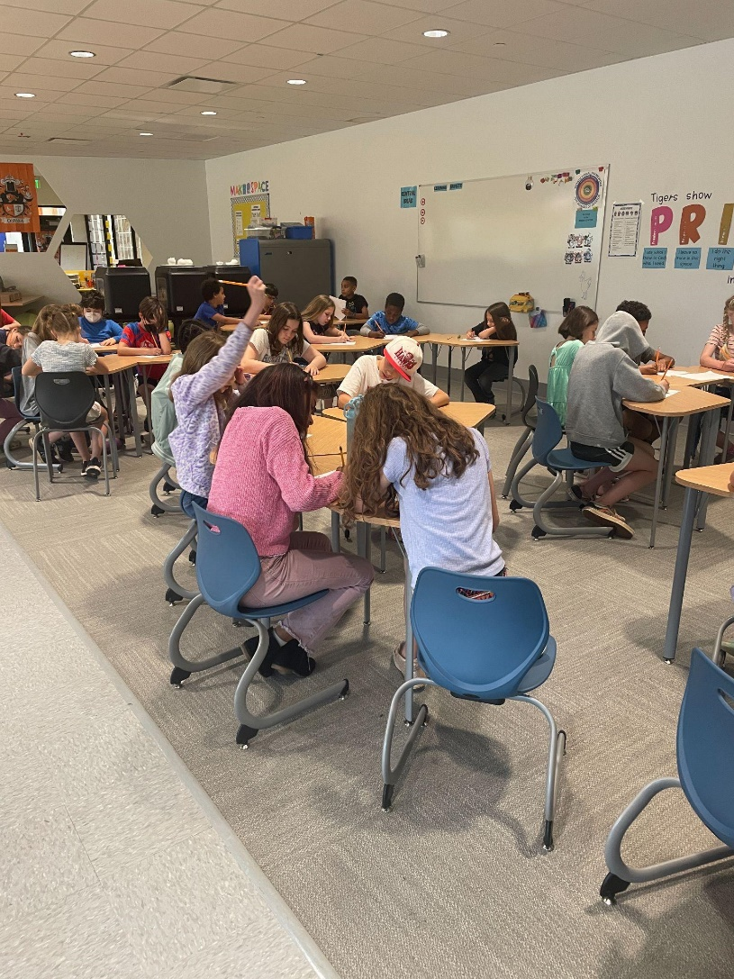
Write, edit, repeat!
Give students 10 minutes to free write.
Have them make as many mistakes as possible on the page.
That’s what revision is for!

Slide 16

Student Sharing on “Wonder”
Students could be divided into pairs or small groups, reading their poem one at a time and sharing what they’ve learned about themselves from their poem.

Slide 17



Hive Mind Poetry Activity
Gathering a list from friends, family or your own memories of life moments.

Slide 18
Self-Questioning Poetry Activity
Asking questions of yourself, the world, and your place in it?
Will I have an impact on society in a positive way?
When I grow up will I become a fundamentally different person than who I currently am?
Using a poetry form, in the case of” Wonder” - The Bop - to help structure your thoughts in a way where you’re not flailing in your writing.

Slide 19
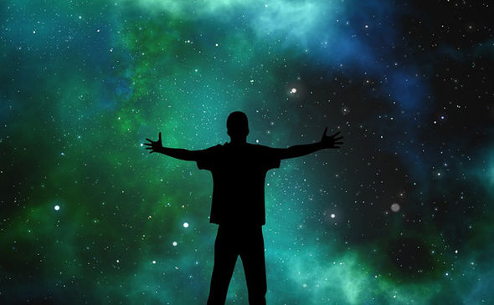
“Children’s poets are the investigative reporters of our universe.”
Charles Waters
Humble Human

Slide 20

More Classroom Connections
Create a classroom “Better World” Dictionary
Each student takes a letter of the alphabet.
Brainstorm other “better world” words for that letter.
Write a poem for that word using one of the poetry forms in the book.
Collect all poems in a classroom book.

Slide 21
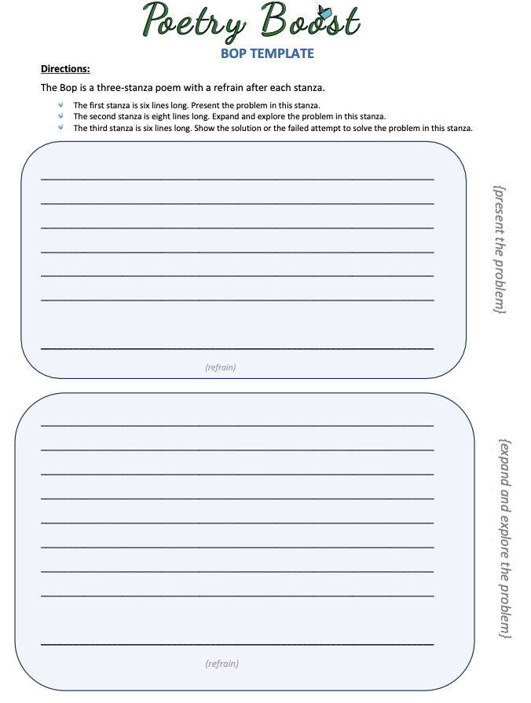
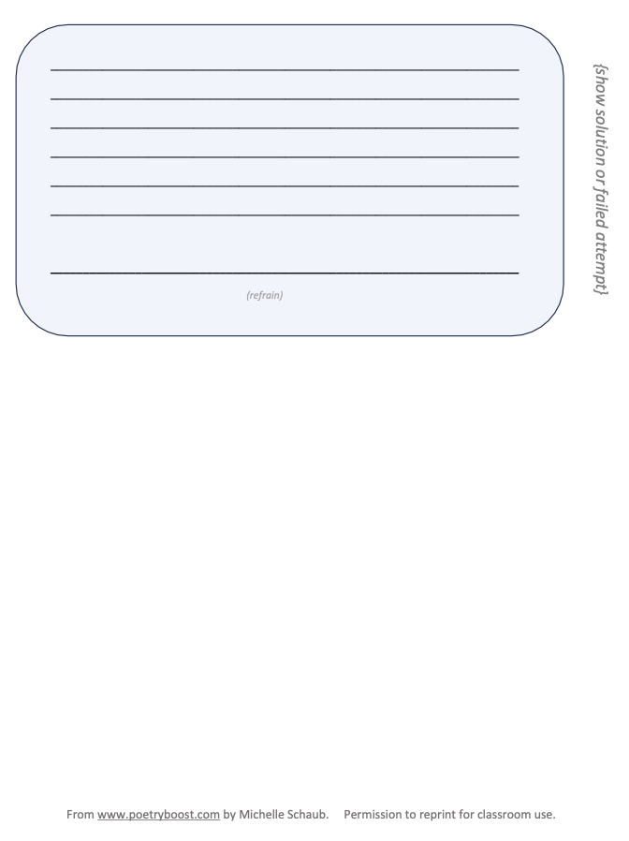
More Classroom Connections
Use this template to write a BOP poem:
www.poetryboost.com

Slide 22
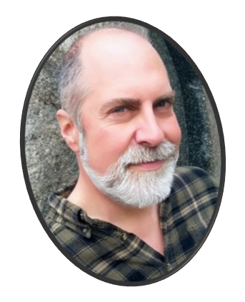

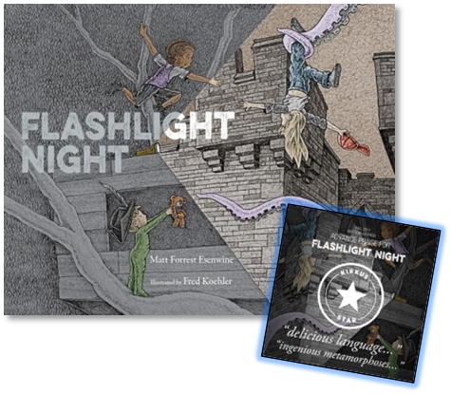
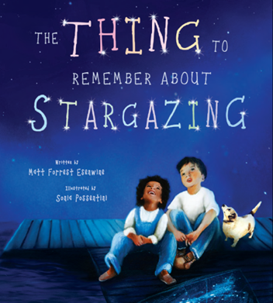
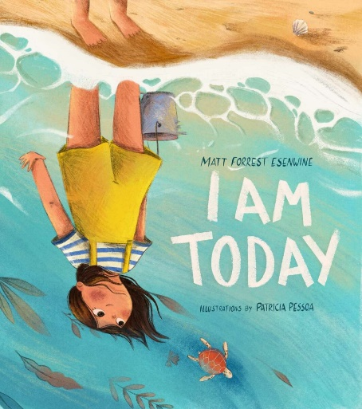
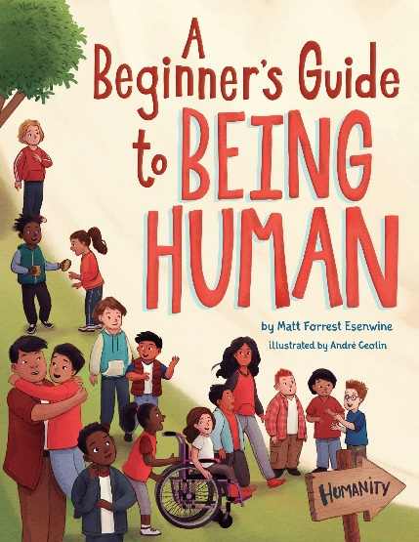



Matt Forrest Esenwine
Author - Poet - Presenter

Slide 23
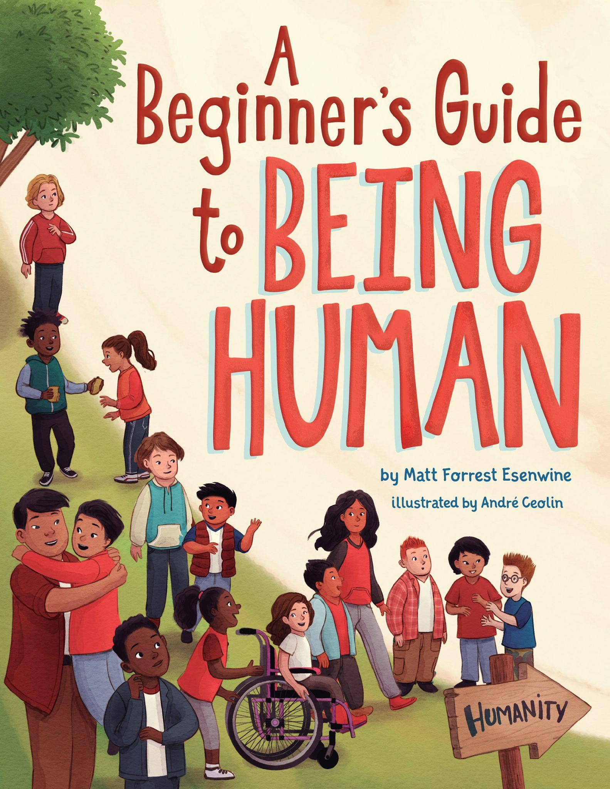
Matt Forrest Esenwine
Family (you don’t need to be related!)
Kindness (kindness is always possible)
Empathy (imagine how the other person feels)
Compassion (put empathy into action)
Forgiveness (this goes for grown-ups, too!)
Love (can be kindness, empathy, compassion, etc.)
“We all feel/experience the same things”

Slide 24
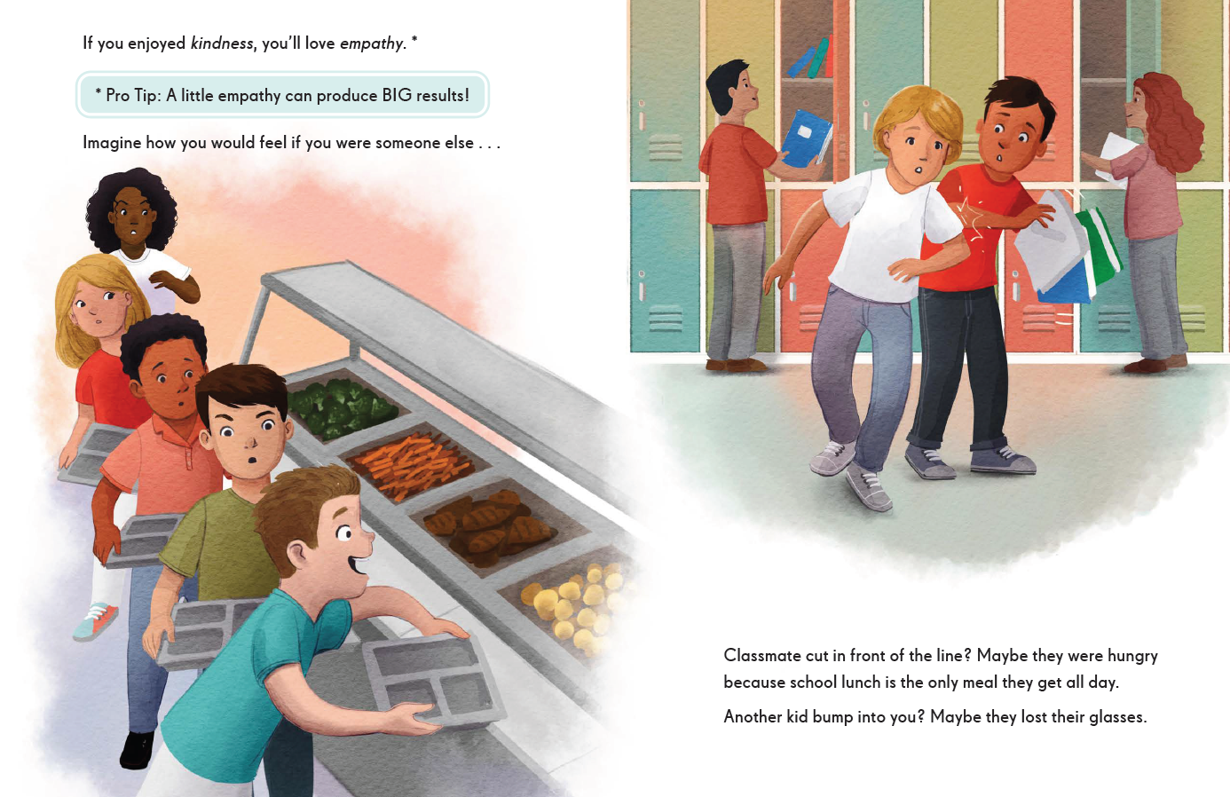
Picture books as mirrors

Slide 25
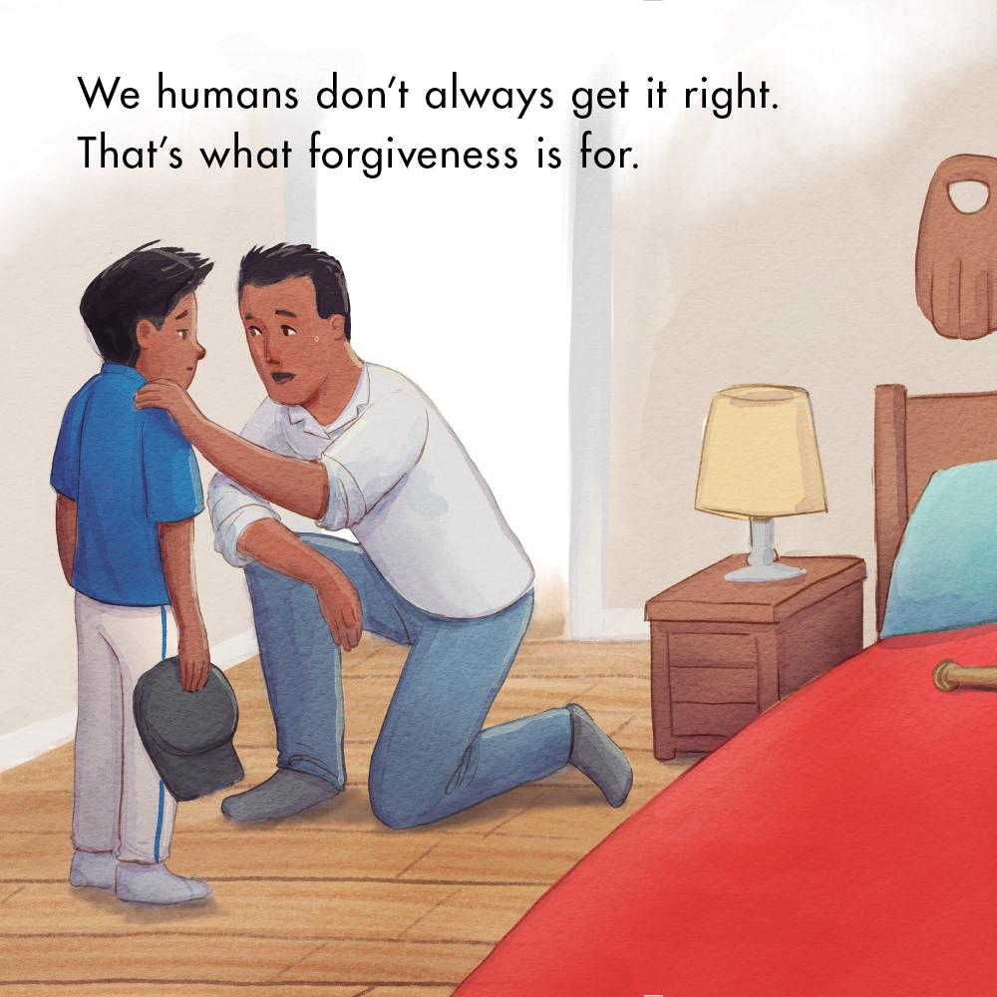
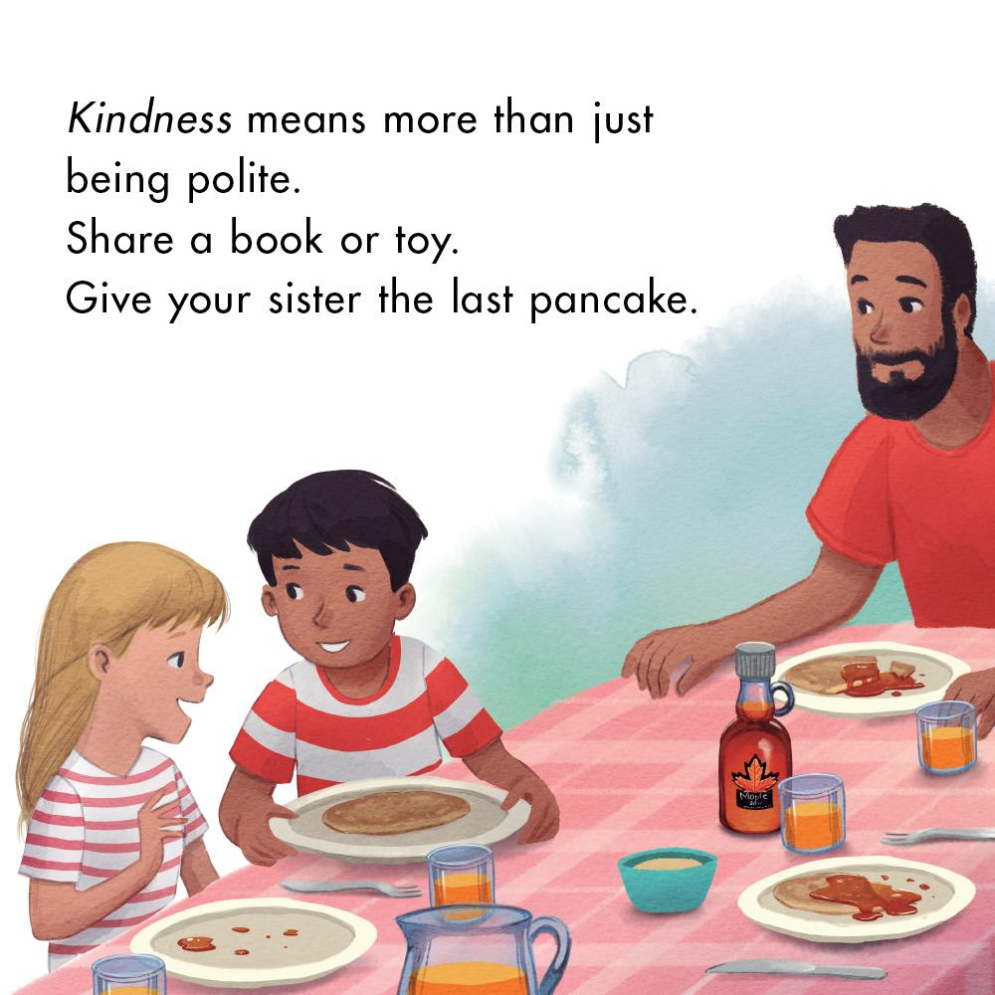
Picture books as mirrors

Slide 26
Poetry as a mirror
“Home”
Give me room to be your friend;
give me space to stretch and run,
a place to sleep, time to mend.
Yes, I owe so much to you.
I am not ungrateful, no –
though I’m tired, and starving, too.
My whole world has been a cage,
cold and cramped. I should not ask
for anything, at my age,
nor should I expect concern,
love, or care – yet, very soon
a new home, rules, words to learn.
Neither knows how this will end,
but I am loyal. Trust me, please.
Give me time; I’ll be your friend.
¬ ©2024 Matt F. Esenwine

Slide 27
Activity: “What If?”
Pick a subject, location, activity, & problem
Ask questions: Why? How? When?
What might the subject do (or never do)?
Then…put yourself in the scene: What if you were the subject? What if you were with the subject? What if you were a bystander? You now have a writing prompt!
-- Share answers, or work together in pairs --

Slide 28
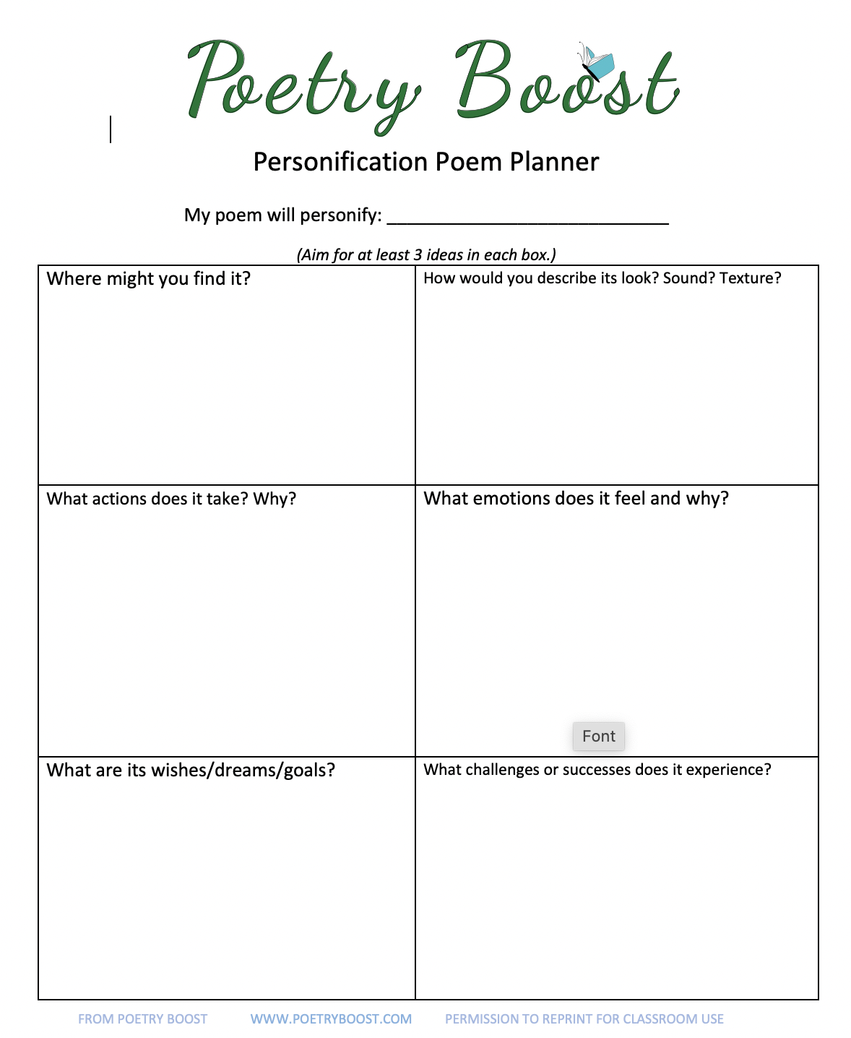

More Classroom Connections
Continue to Build Empathy with Personification Poems!
www.poetryboost.com

Slide 29
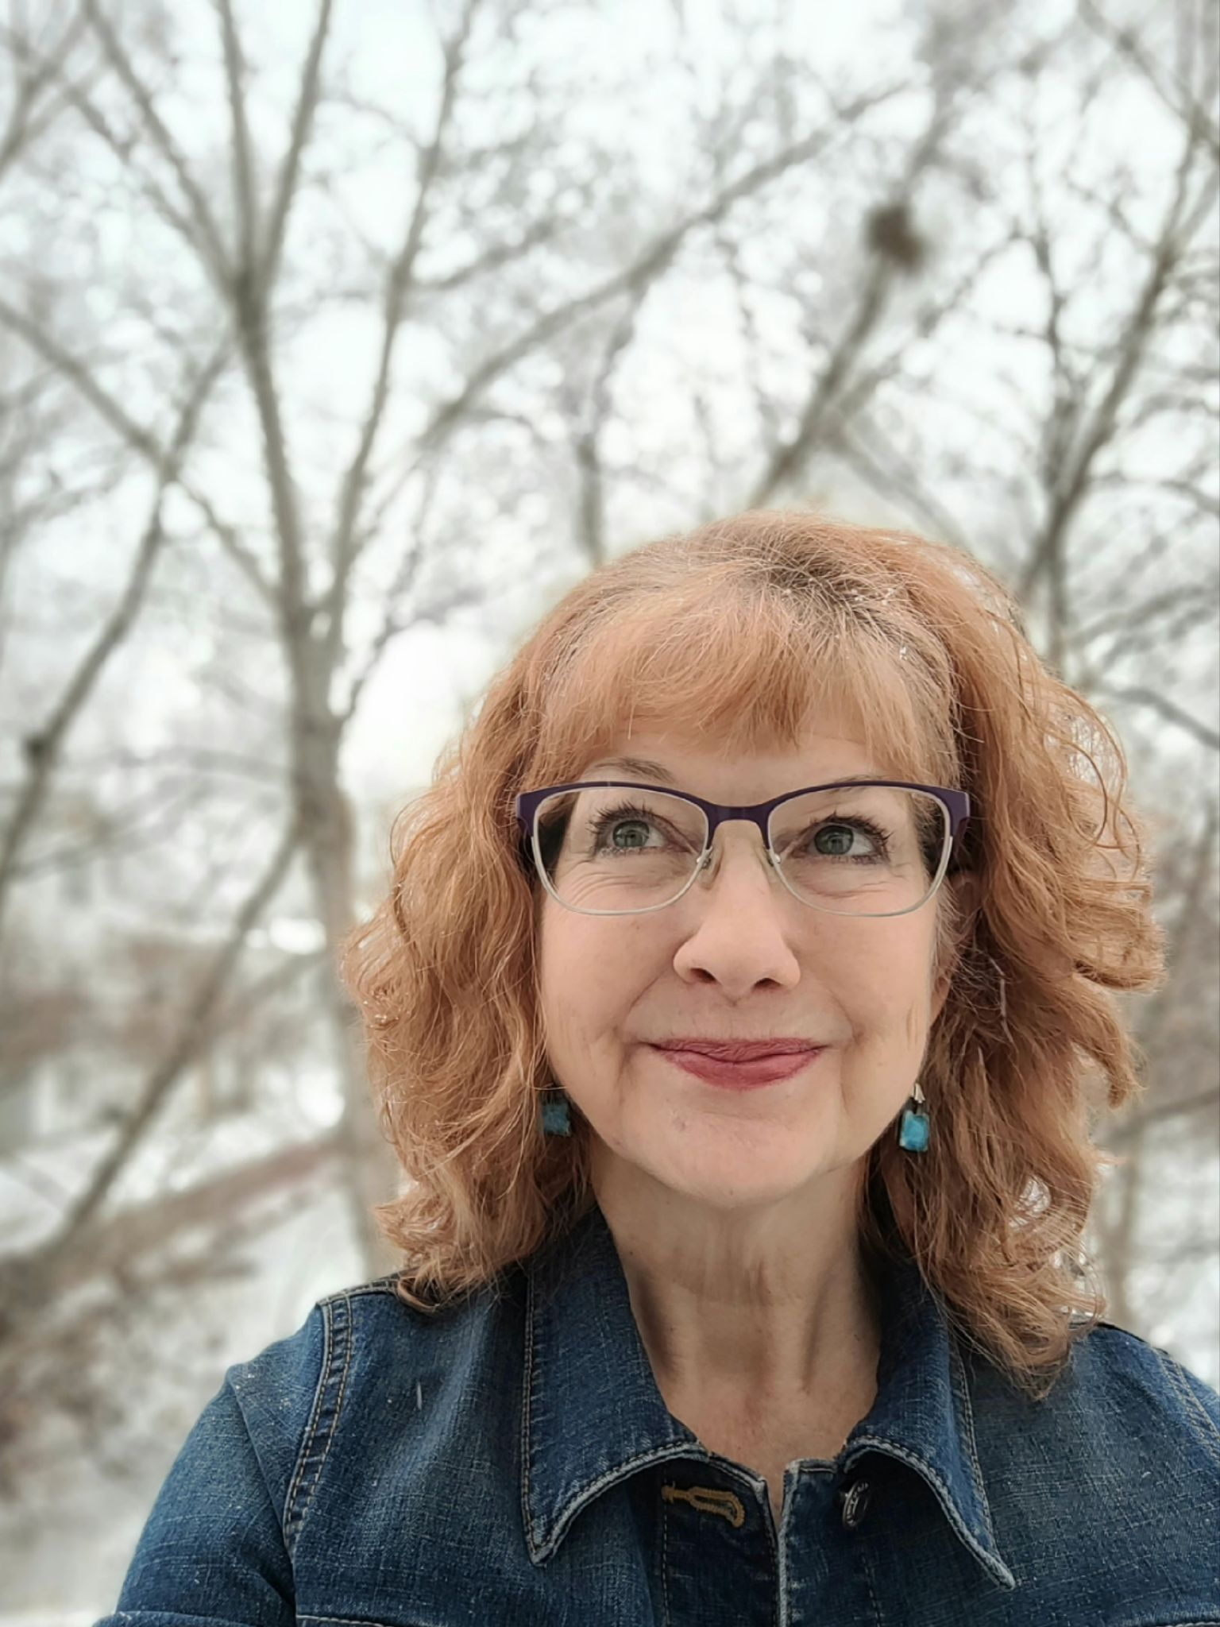

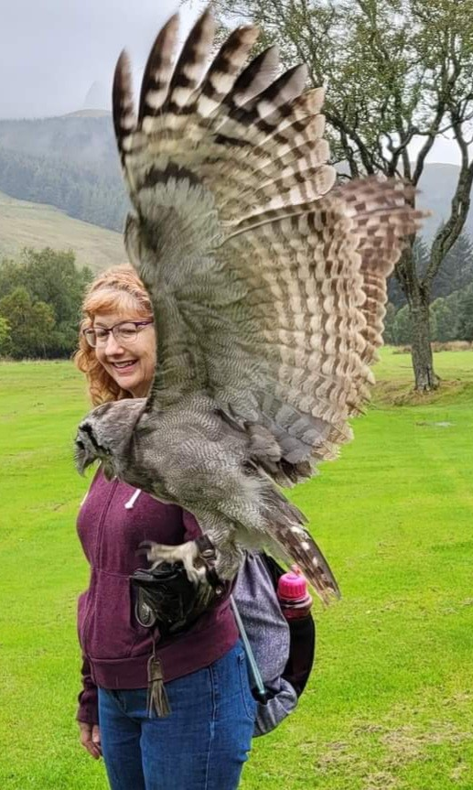
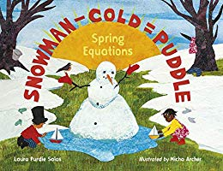
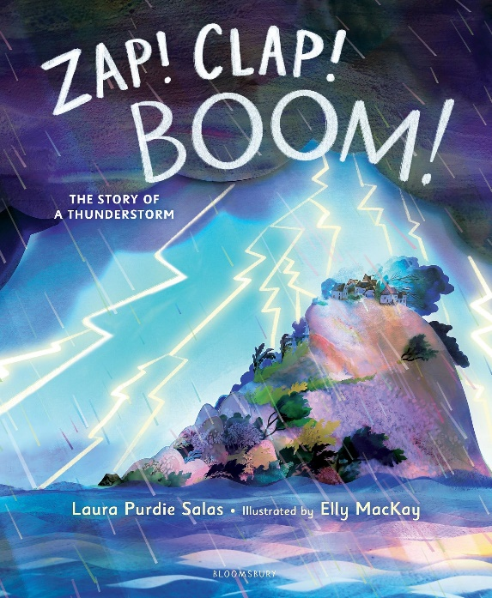
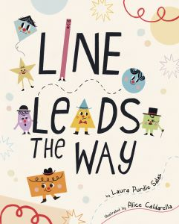
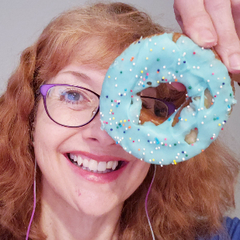
Laura Purdie Salas
writer * poet * visiting author
laurasalas.com
(sign up for my
newsletter :>)
@LauraPSalas

Slide 30
YOU share first!
Conversation Starters
How do you think X (that person, that character) feels about Y?
Has something like that ever happened to you?
How do you feel about it?

Slide 31

Finding Family
Charlotte Zolotow Honor Book
CCBC Best Books of 2024
Junior Library Guild Gold Standard Selection
Minnesota Book Award Finalist
California Reading Association: Eureka! Gold Medal
2024 ALSC Summer Reading List
Minnesota Star of the North Nominee
laurasalas.com/finding

Slide 32
Themes in Finding Family
1
Family
2
Loss
3
Uncertainty
4
Mindfulness
Traditional and chosen
Of family, expected life, etc.
Even scientists can’t answer everything. Even Google can’t!
We have this moment.

Slide 33
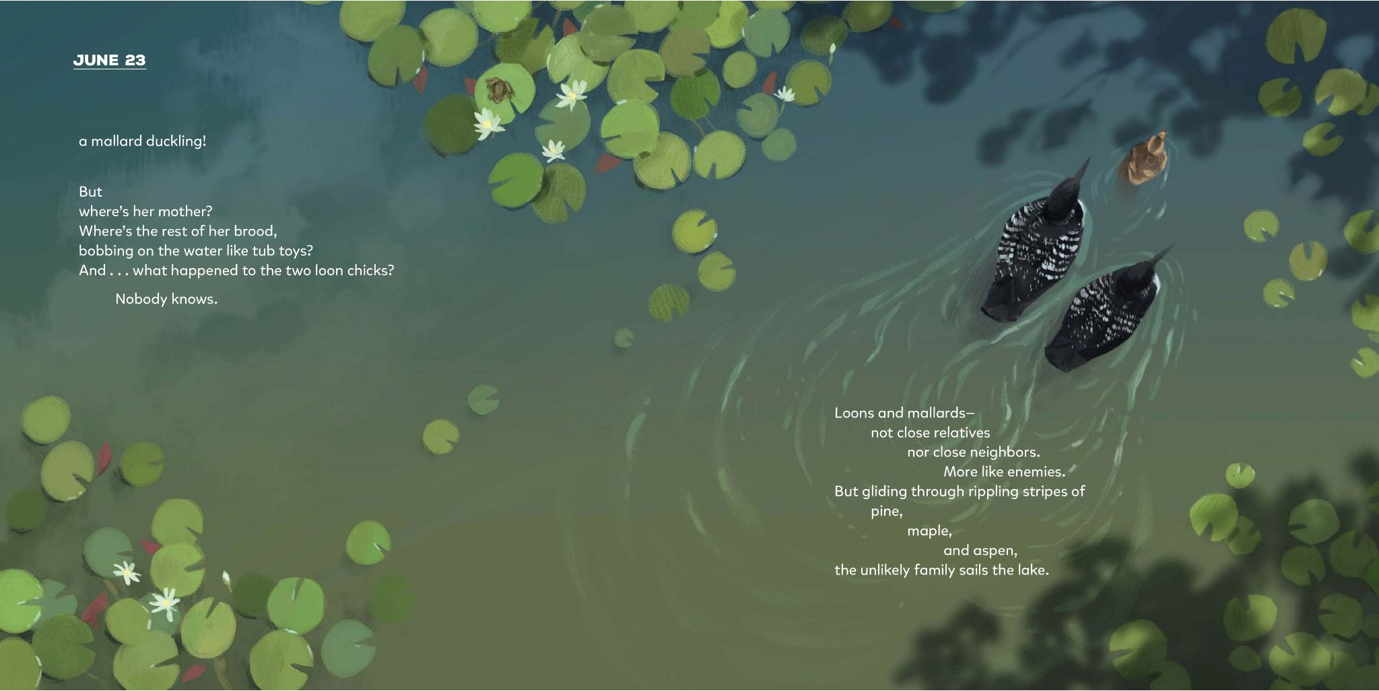
Is everyone in your family alike? How are you different from each other?

Slide 34
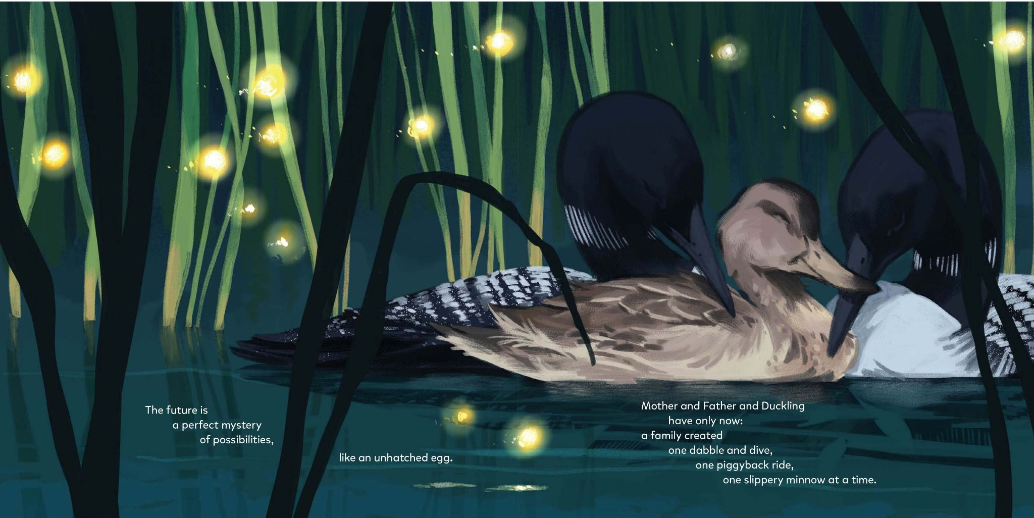
What do you wonder about the future? What’s the difference between wondering and worrying? What do you do to help you focus on what’s happening right now?

Slide 35
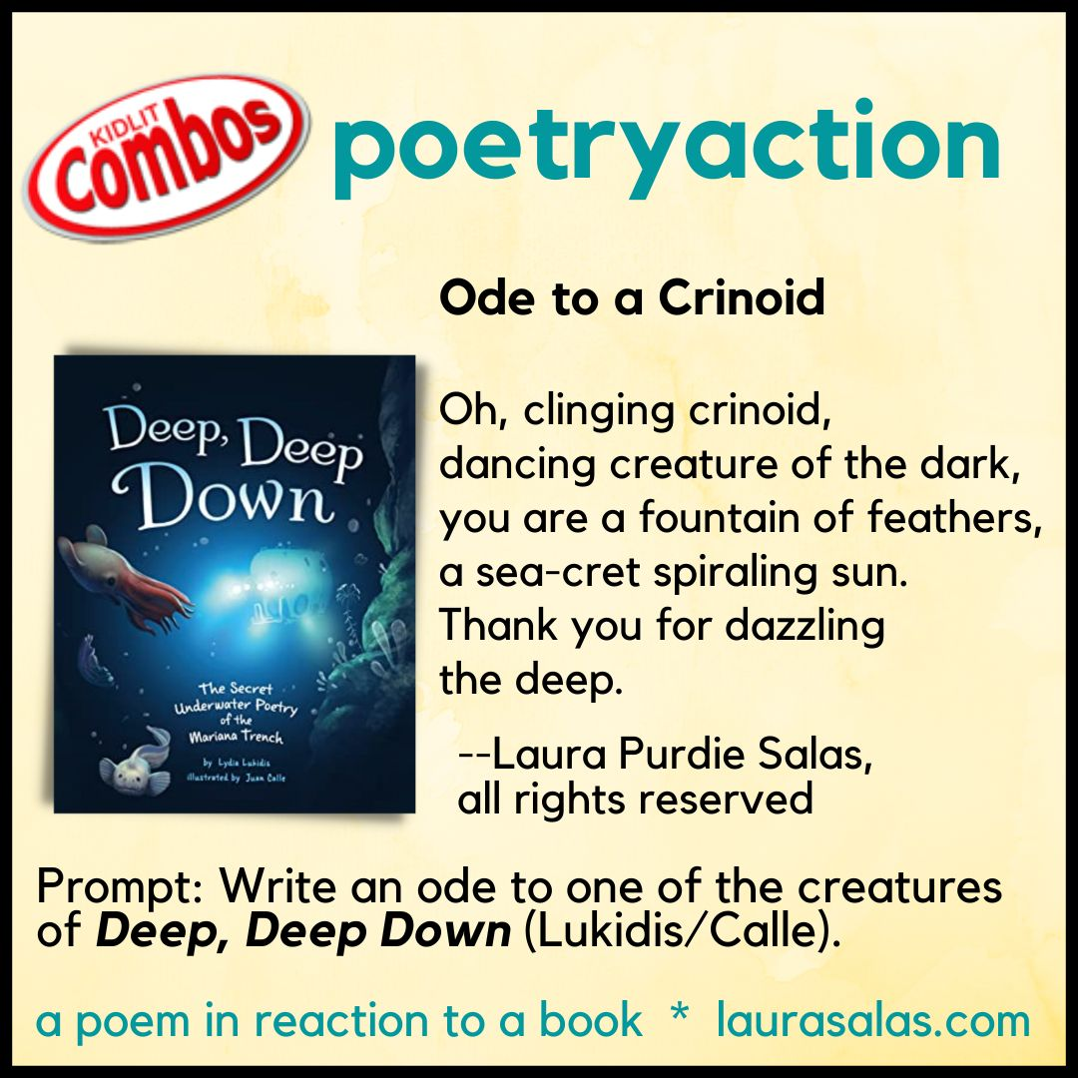
Activity: Poetryaction
Read a book.
Ask some questions:
What does it make me think of?
Which part stands out to me?
What does it remind me of in
my own life?
What did I learn?
Write a brief poem.

Slide 36
Ways To Use Poetryactions
Reader reflection
Introduce book to others
Practice a writing skill
Class response to one book

Slide 37
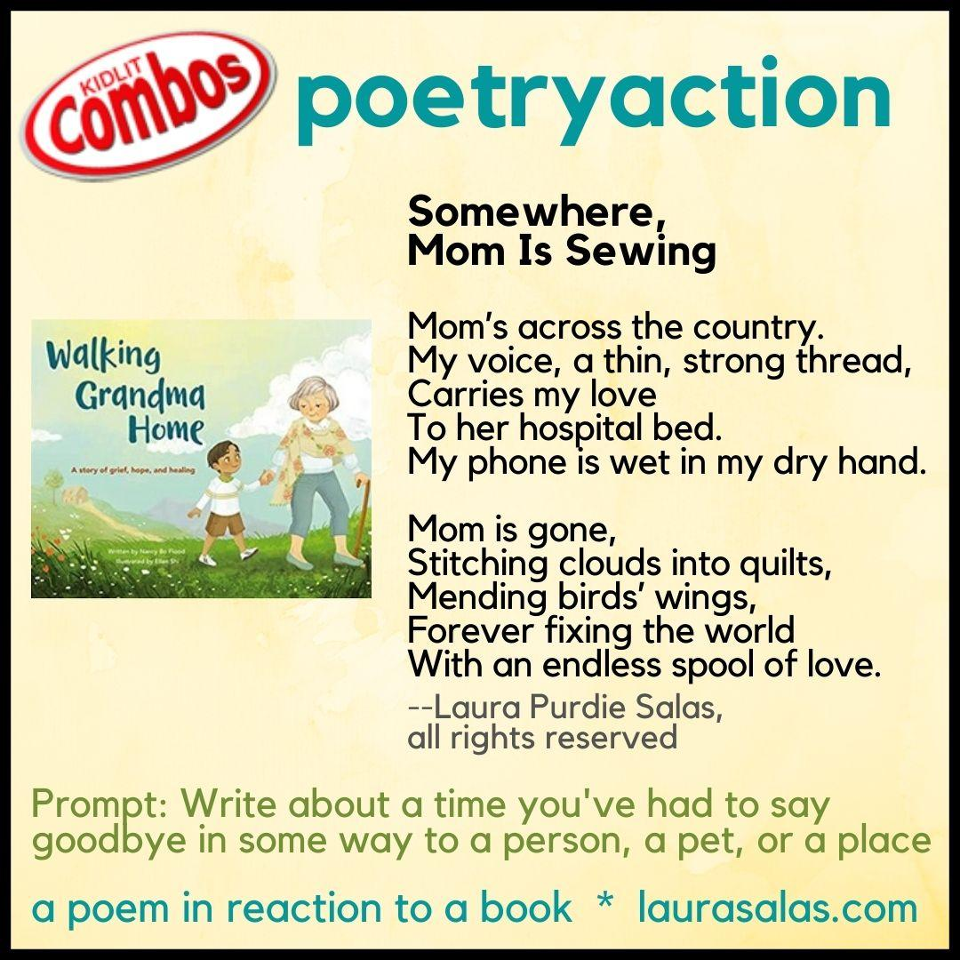
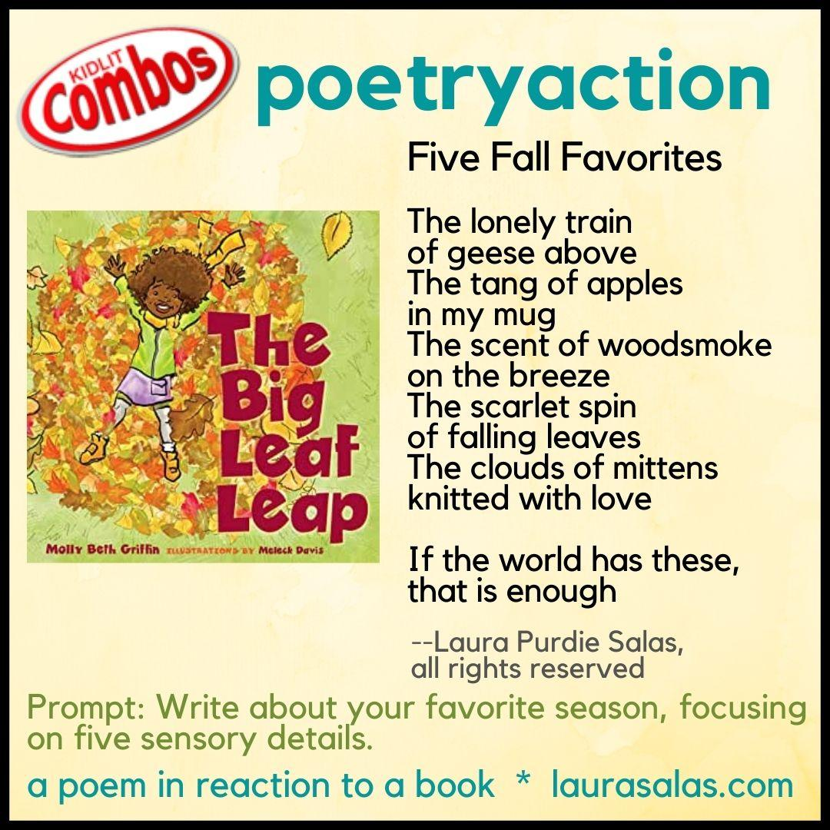
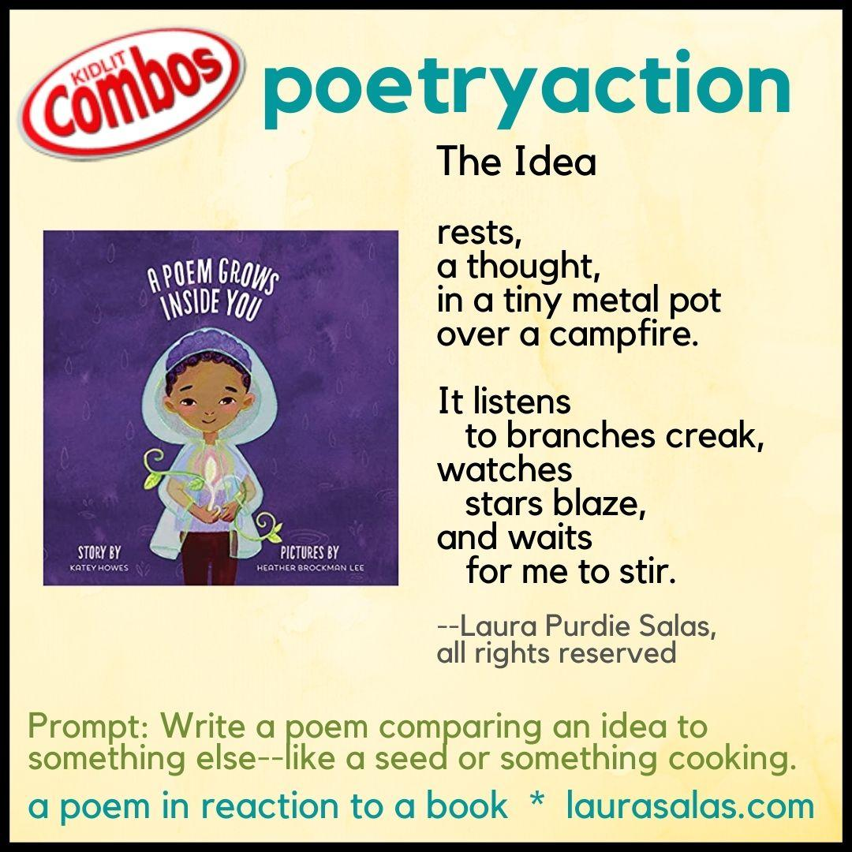
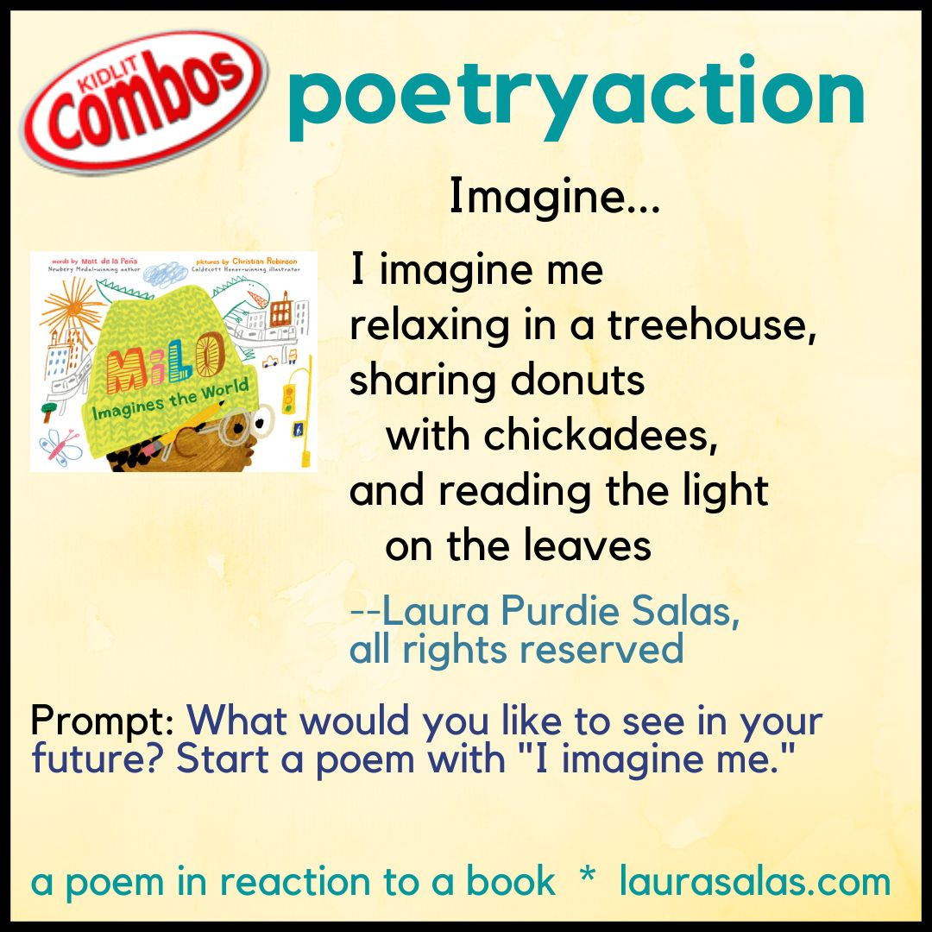
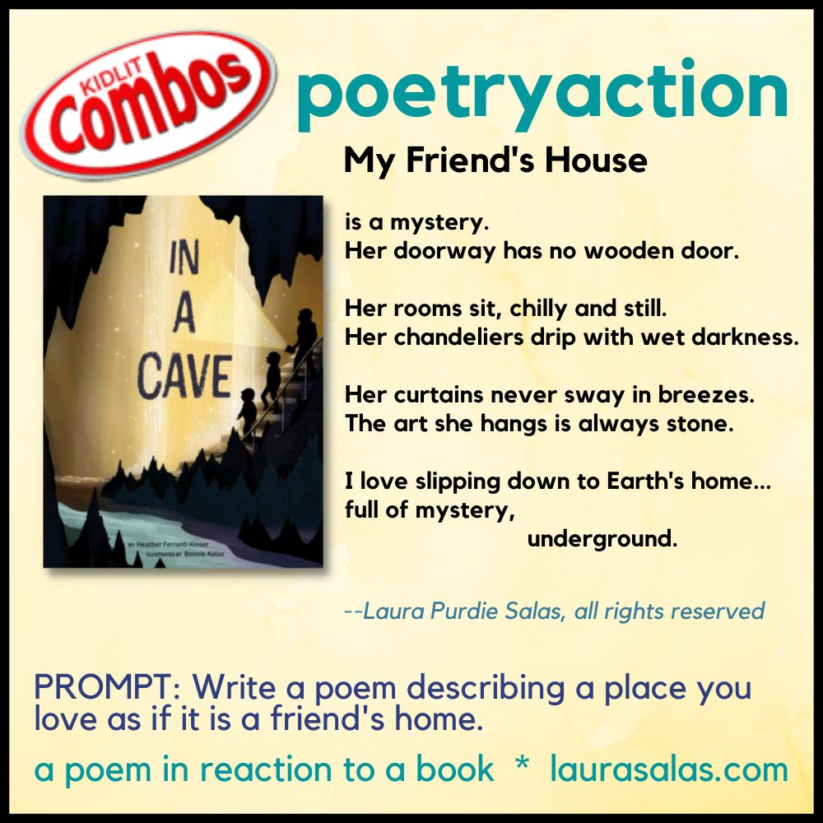
laurasalas.com/poetry

Slide 38

Snowman-Cold=Puddle (Equation Poems)
Junior Library Guild Gold Standard Selection
2020 Bank Street Best Books
New York Public Library’s list of Best Books for Kids
NCTE Poetry Notable
ALA-CBS’s #ReadingBeyond Advanced Reader List
laurasalas.com/snowman

Slide 39
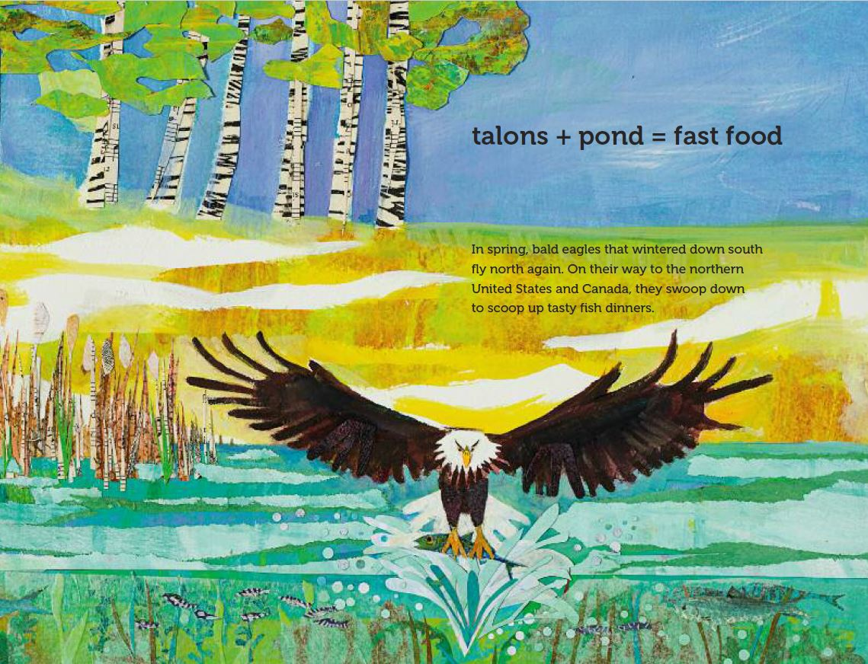

Slide 40
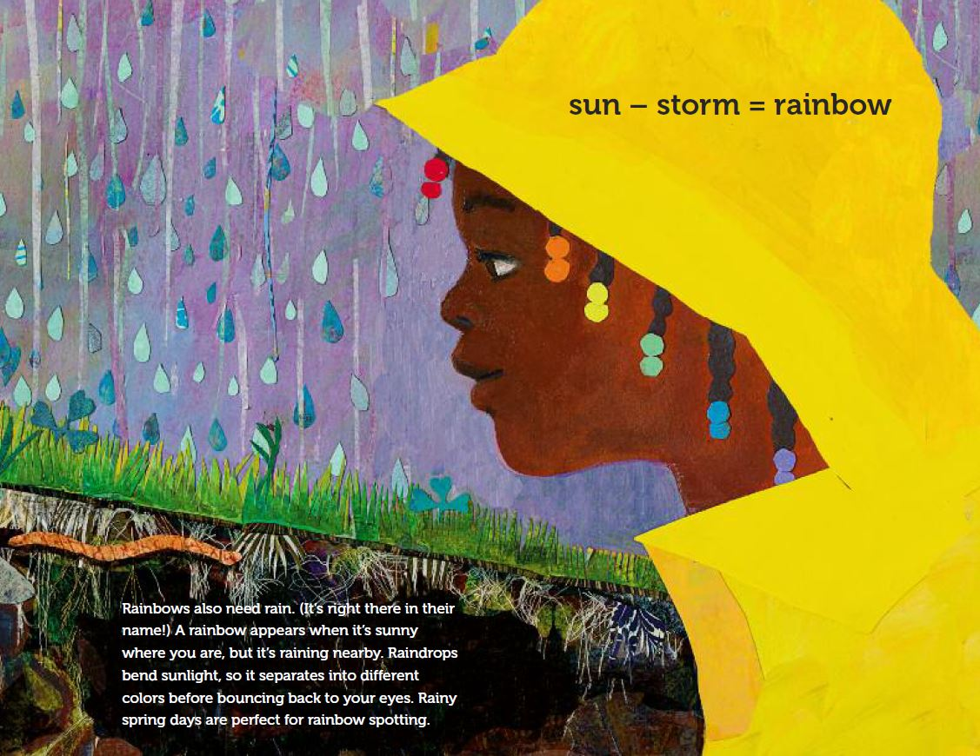

Slide 41
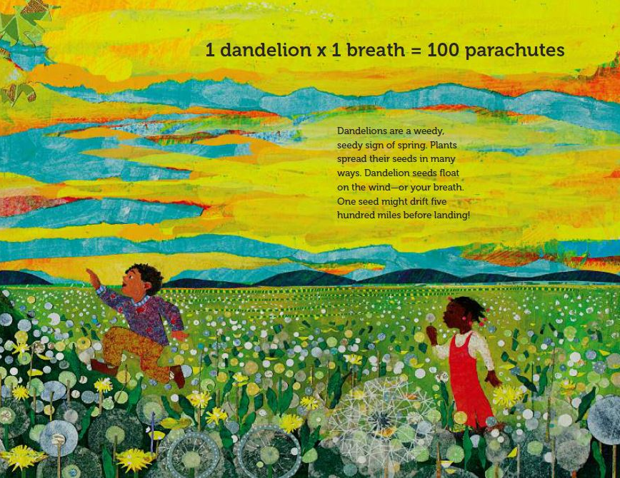
Have you ever picked dandelions?
What did you do with them?
How would YOU “solve” this equation?

Slide 43
Snowman-Cold=Puddle (Equation Poems)
Expressing things in new ways
No single right answer
We reveal ourselves in our writing
We can write about personal things
laurasalas.com/snowman

Slide 44
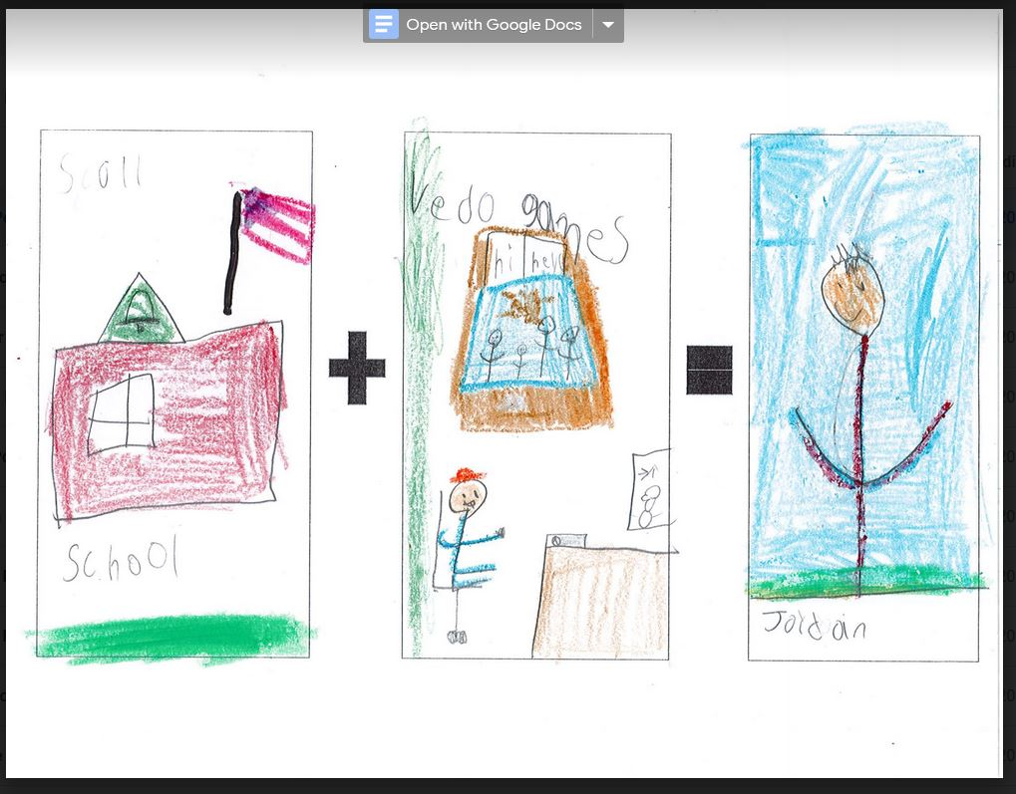
Let kids share how they see themselves

Slide 45
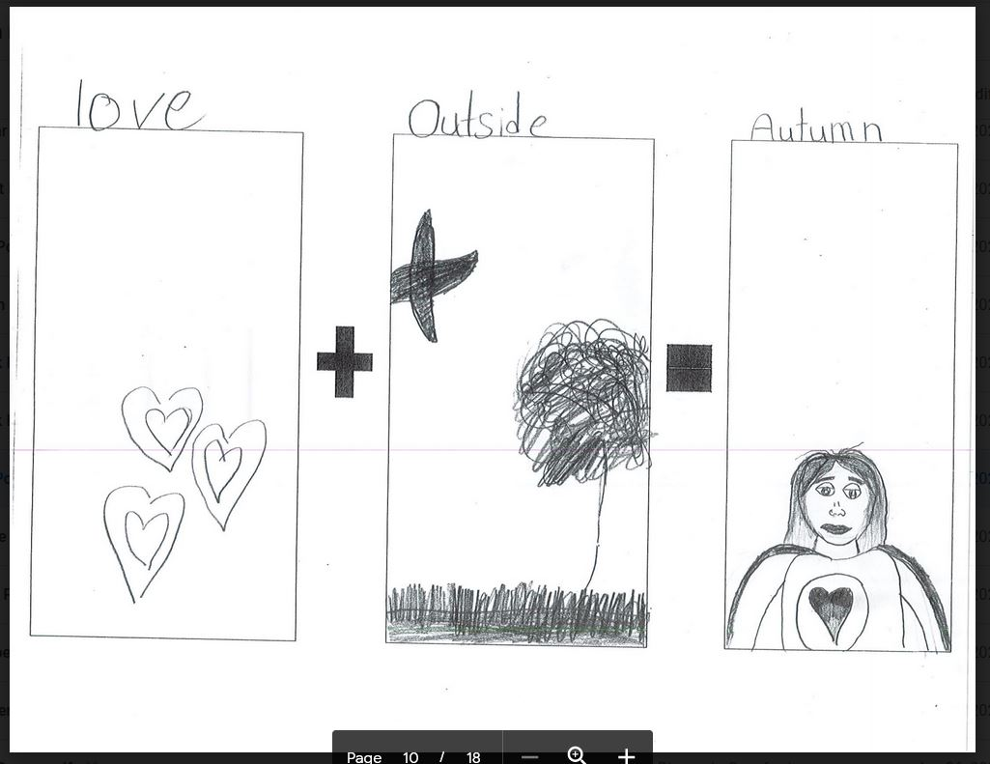

Slide 46
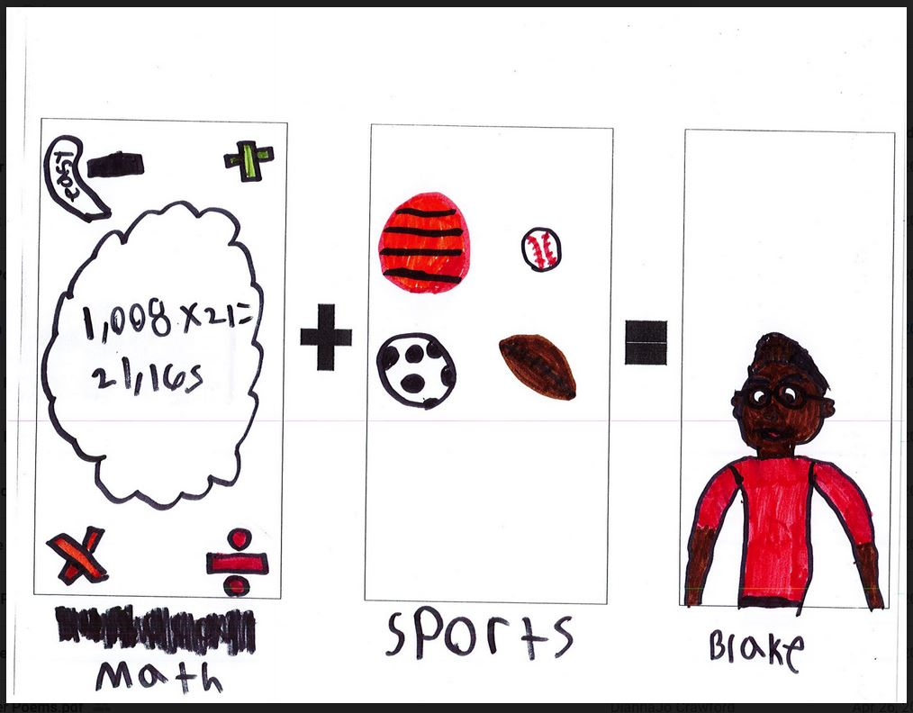

Slide 47
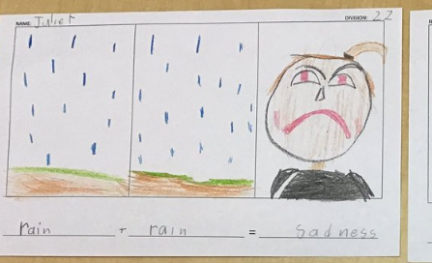

Prompt/invite more info
Uh oh, that’s not a happy face! Did the rain ruin something?

Slide 48
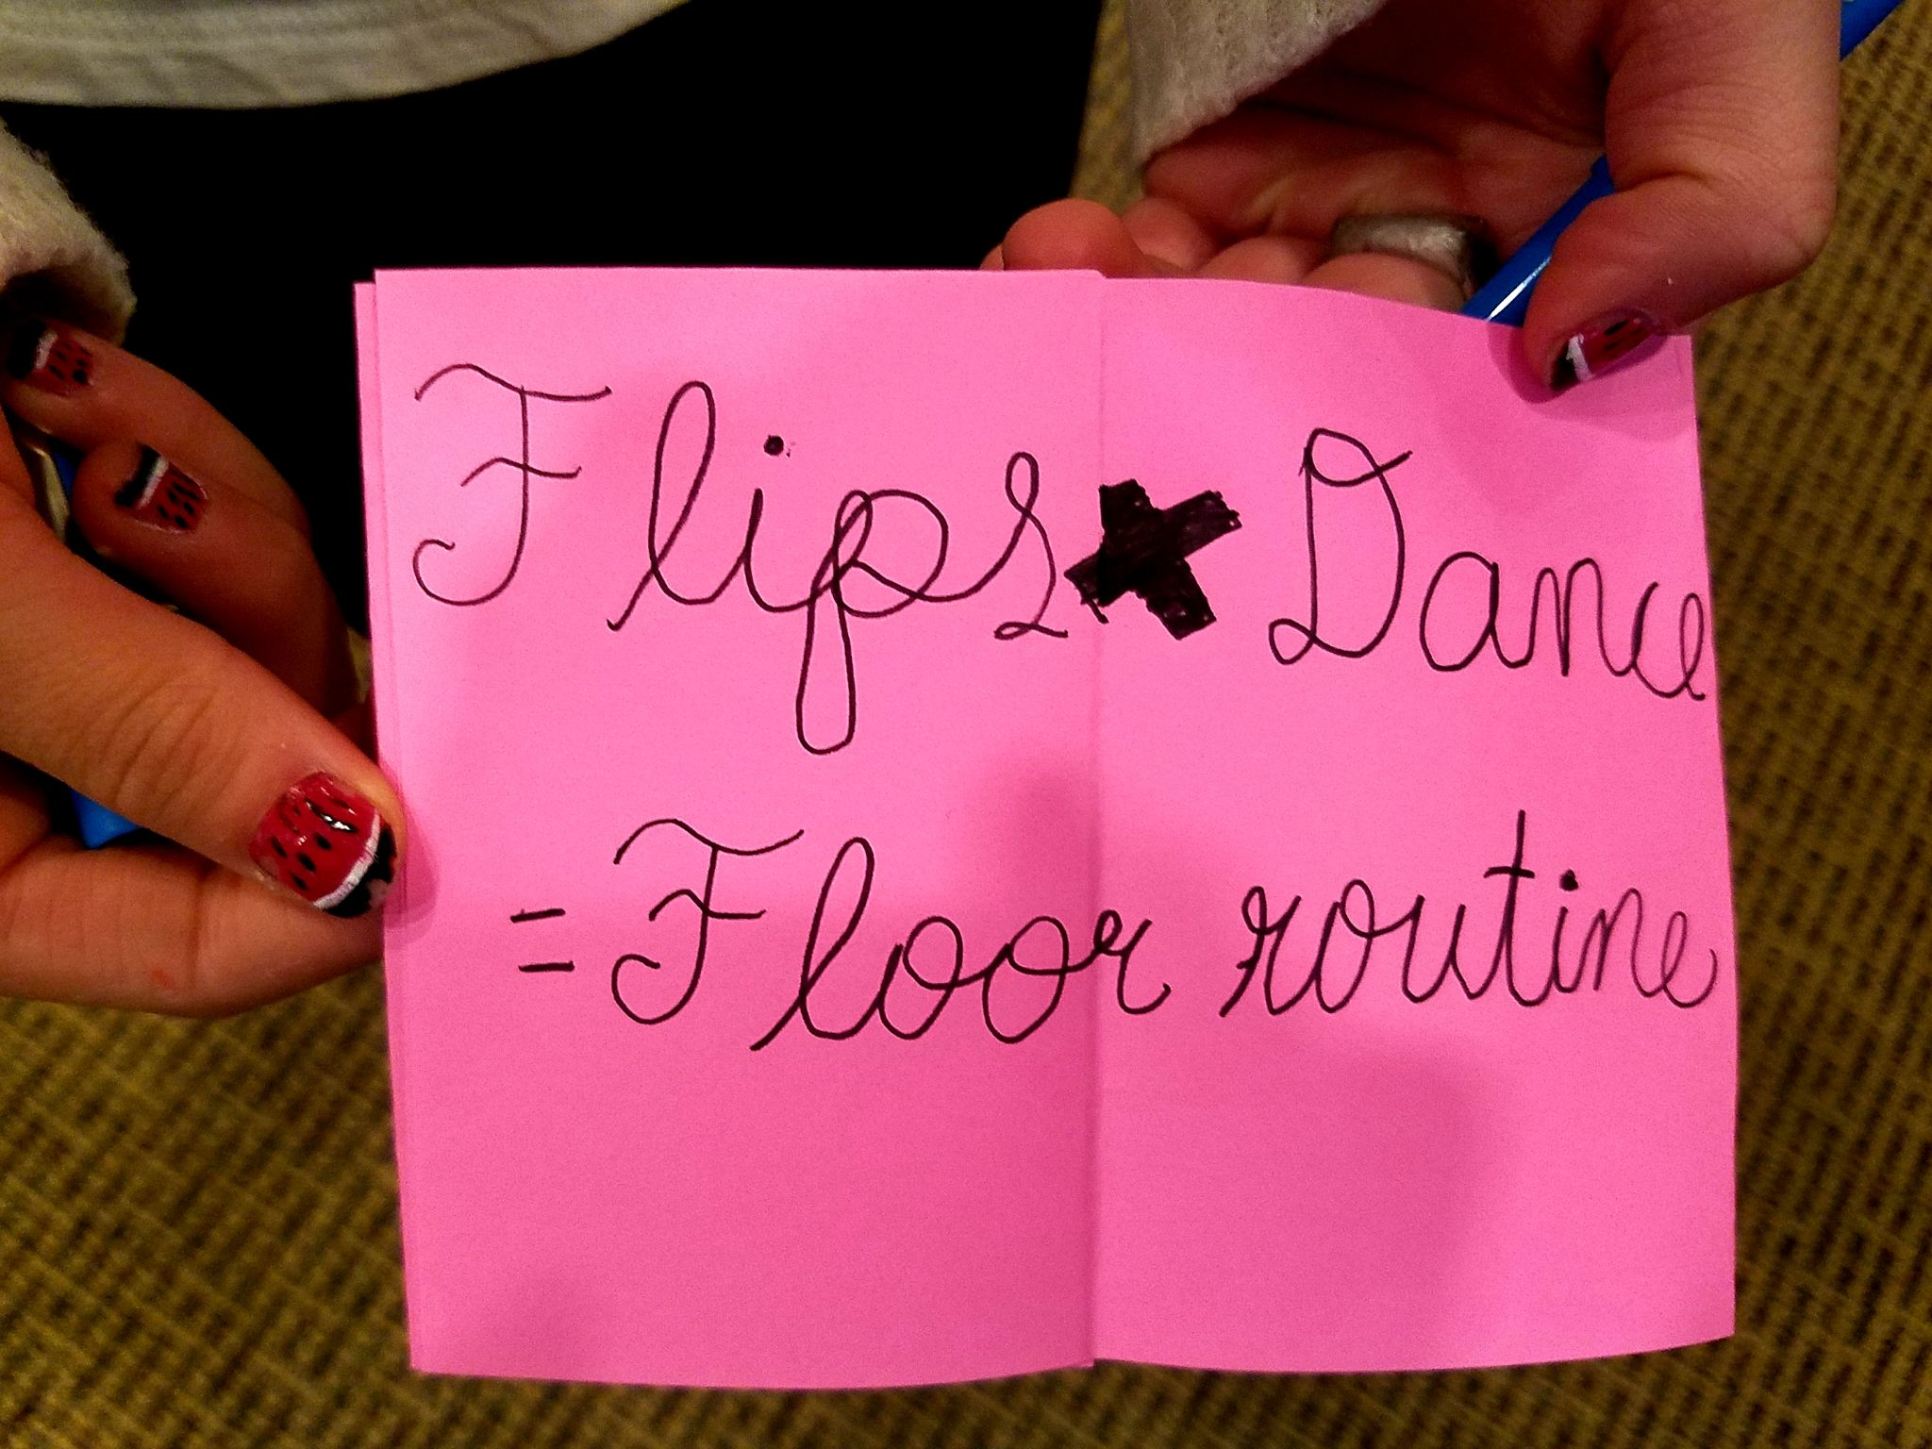
Are you ever scared when you try new tricks?

Slide 49
Activity: Equation Poem
Think about a topic.
Brainstorm what you know and think and feel.
Think about the relationships between some of the things you brainstormed. How do they affect each other?
Write equation poems to reflect those relationships.
______ + ______ = [my name]
______ + ______ = Thanksgiving
Travel - ______ = ______

Slide 50
More Classroom Connections
Use Equation Poems For:
Cross-curricular Topics (science, social studies, literature, SEL)
Exit or Entrance Slips
Ice Breakers
Brain Breaks
Use poetryaction and equation poem mentor texts: laurasalas.com/poetry

Slide 51
Want to download our slides?

Slide 52
Stop by and say “Hi!”
Charles Waters TODAY:
11:30am - The Mistakes That Made Us Book Signing with Irene Latham - Location: Lerner Booth #833
12:30pm - Children’s Book Award Luncheon - Location: Room 210 B (Level 2)
4:15pm - Notables Awards Session - Location: 157 C (Level 1)
Matt Forrest Esenwine TODAY:
2-3pm: “The Thing to Remember about Stargazing” (Tilbury House) signing
Location: W.W. Norton Booth #823
3:30-4:30pm: “A Universe of Rainbows” (Eerdmans Books for Young Readers) ARC signing
Location: Eerdmans Booth #208

Slide 53
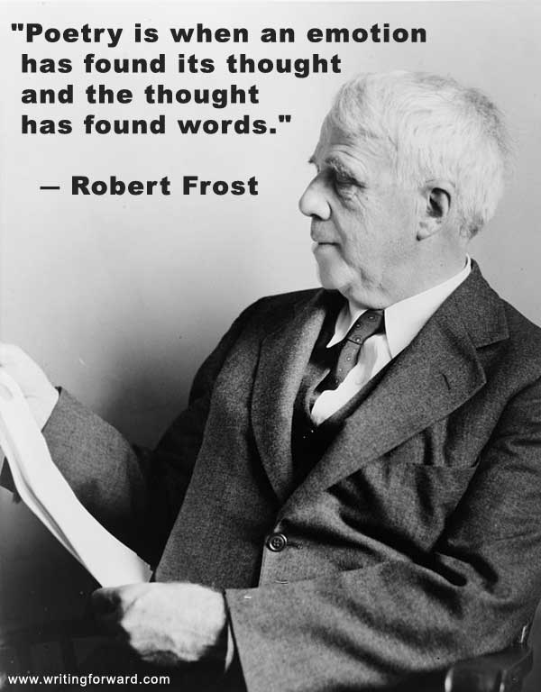

YOU ALL ARE AWESOME!!!!!!!

